Slide 1
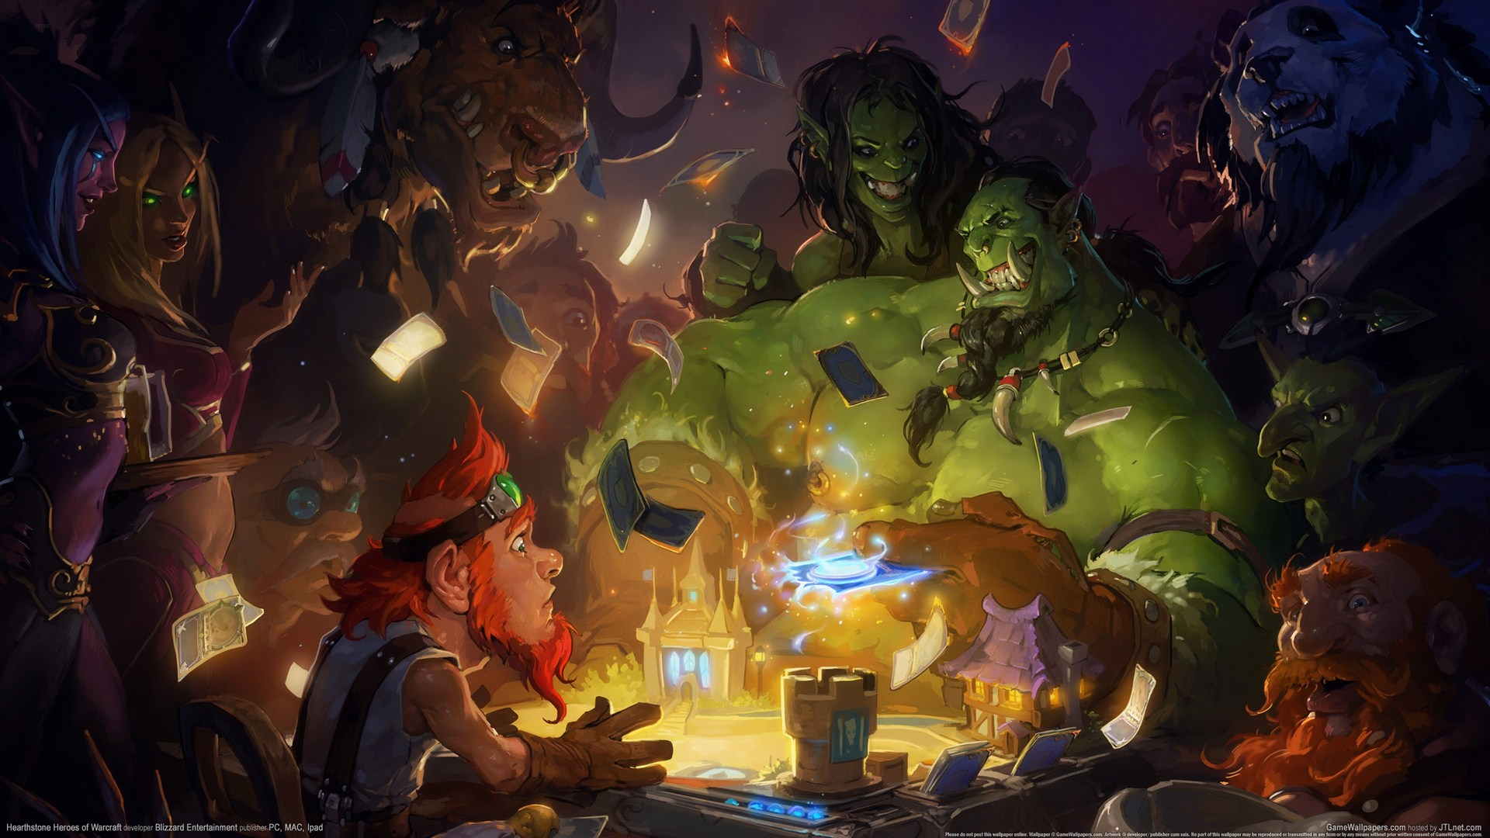
Hearthstone Arena Deck Builder
By Jordan Silver

Slide 2
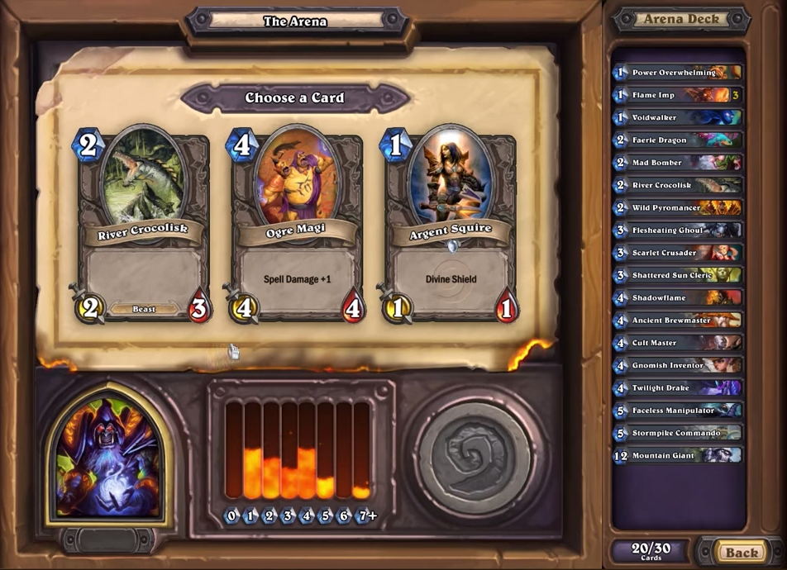

Slide 3
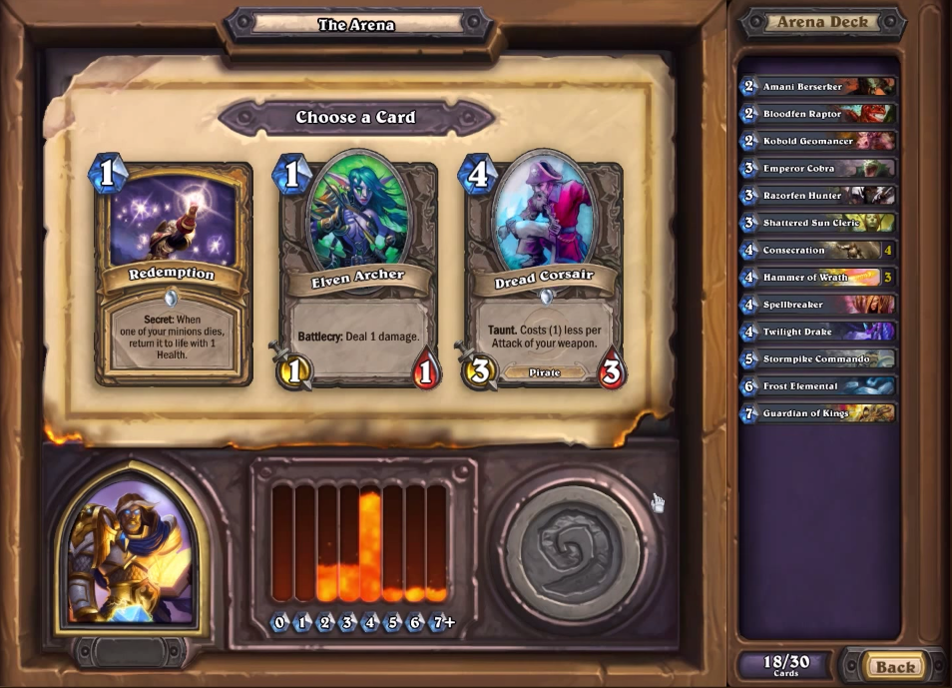
Mana Curve
Deck View

Slide 4
Screenshots of the hero selection and card selection pages
Mention 9-patch used for BG

Slide 5
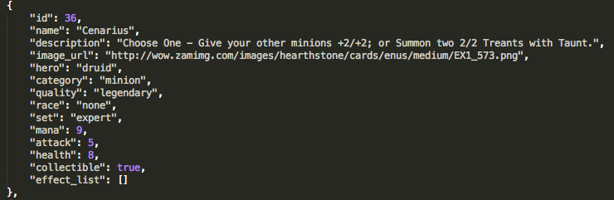
Card Data via: https://github.com/pdyck/hearthstone-db
Mention asynch tasks

Slide 6
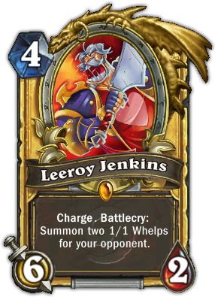
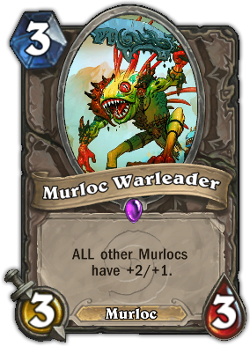
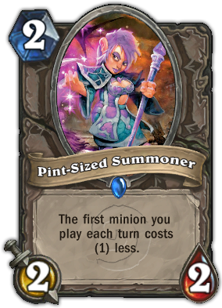
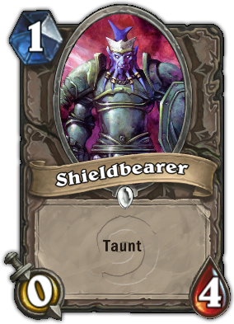
Card Rarities
Legendary: 2%
Epic: 4%
Rare: 15%
Common: 79%

Slide 7
List view details

Slide 8
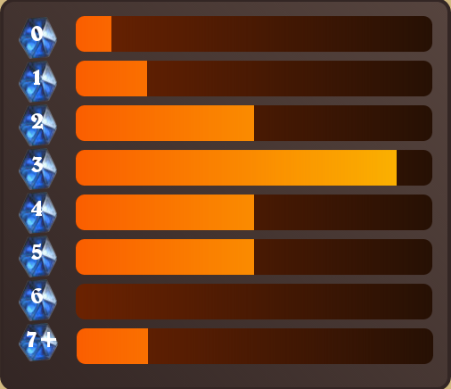
Mana Curve
Mana bar details

Slide 9
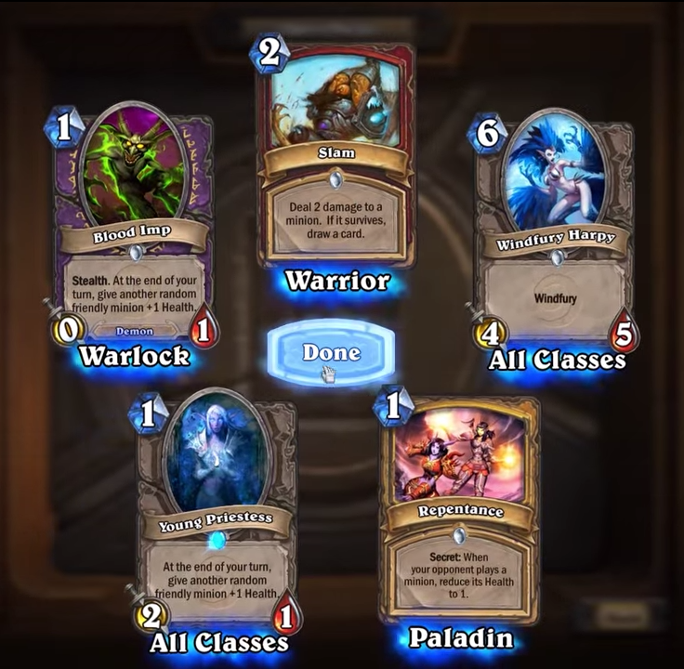

Future Expansion
Google Play
Pack Opening Sim

Slide 10
Closing remarks

